Slide 1
Forecasting Sales in R with Time Series Models and Stochastic Gradient Boosting

Slide 2
Project analysis slide 2
Intro to Problem
A retailer wishes to forecast total POS for several of its stores for the coming month
Data is provided at the store level, with various features from the retailer
Assume sales are impacted by internal store events (promotions, holidays, etc.) as well as external market events

Slide 3
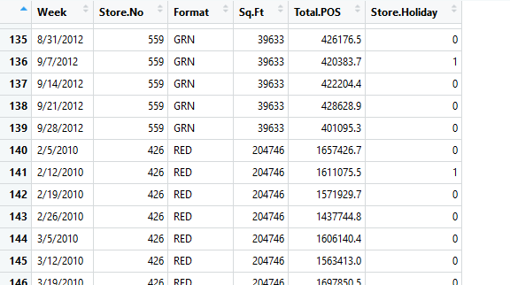
Project analysis slide 2
Intro to Data
Time Stamp
Dep.
Var
Store
Vars.

Slide 4
Project analysis slide 2
Intro to Data
Week: time stamp
Store.No: retailer’s store id number; not quantitative input
Format: retailer’s store format; another classification variable
Sq.Ft: total square footage of the store footprint
Total.POS: dependent variable; POS sales for the store, by week
Store.Holiday: indicator showing if the store treats the week as a holiday

Slide 5
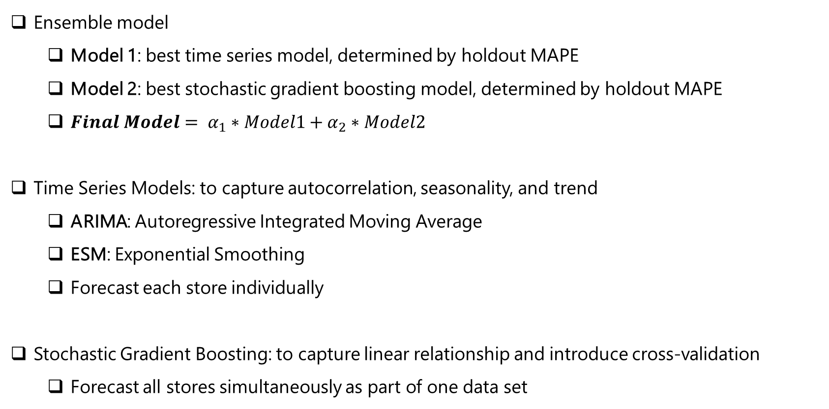
Project analysis slide 2
Modeling Approach
Ensemble model
Model 1: best time series model, determined by holdout MAPE
Model 2: best stochastic gradient boosting model, determined by holdout MAPE
${Final Model= α}_{1}∗Model1+α_{2}∗Model2$
Time Series Models: to capture autocorrelation, seasonality, and trend
ARIMA: Autoregressive Integrated Moving Average
ESM: Exponential Smoothing
Forecast each store individually
Stochastic Gradient Boosting: to capture linear relationship and introduce cross-validation
Forecast all stores simultaneously as part of one data set

